Slide 1
Multiple Inheritance

Slide 2
Outline
Multiple Inheritance in Java
The Diamond Problem
Interfaces

Slide 3



Multiple Inheritance
Multiple Inheritance is a feature in object orient programming where a child class can inherit properties of more than one parent class.

Slide 4
Multiple Inheritance
Unlike other popular object-oriented programming languages such as C++, java does not provide support for multiple inheritance for classes.

Slide 5
interface
Father
{
}
interface
Mother
{
}
public class
Daughter implements Father, Mother
{
}

Slide 6
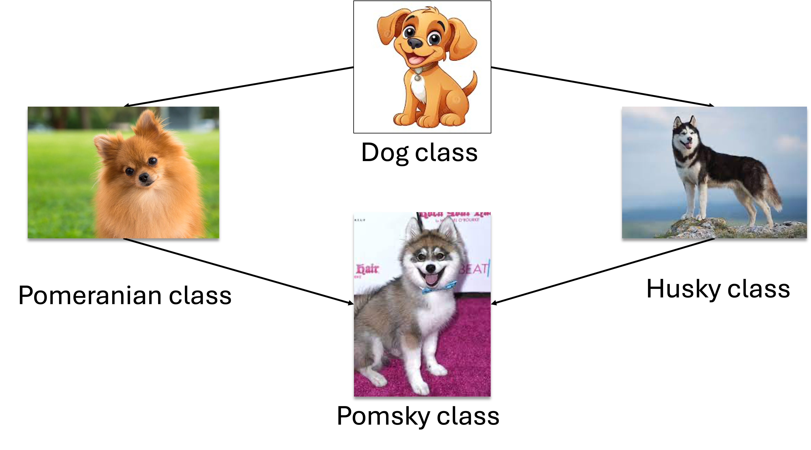
The Diamond Problem
Java does not support multiple inheritance in classes because it can lead to the diamond problem.

Slide 7
The Diamond Problem
The diamond problem is a situation where the compiler does not know exactly which class method to execute if that class method is defined in the parent class and its child classes.

Slide 8




Dog class
Pomeranian class
Husky class
Pomsky class

Slide 9
class Dog
bark()
class Pomeranian
bark()
class Husky
bark()
The bark() method is ambiguous because java does not know which bark() method to execute.
class Pomsky

Slide 10
public class
Dog
{
public void bark();
}
public class
{
Pomeranian extends Dog
public void bark() {“Pomeranian is barking“;}
}
public class
Husky extends Dog
{
public void bark() {“Husky is barking“;}
}

Slide 11
public class
Pomsky extends Pomeranian, Husky
{
}
{
public class App
public static void
main
(String[] args)
{
Pomsky mypomsky = new Pomsky();
mypomsky.bark();
Which bark() method are you referring to ???
}
}

Slide 12
public class
Pomsky extends Pomeranian, Husky
{
}
{
public class App
public static void
main
(String[] args)
{
Pomsky mypomsky = new Pomsky();
mypomsky.bark();
Java does not support multiple inheritance in classes to avoid all the complexity
and to keep things simple and straightforward.
}
}

Slide 13

class Dog
bark()
class Pomeranian
bark()
class Husky
bark()
class Pomsky

Slide 14
Outline
Multiple Inheritance in Java
The Diamond Problem
Interfaces

Slide 15
Interface
Multiple Inheritance is supported in java through interfaces.
There will be no ambiguity because interfaces only declare methods and the actual implementation will be done by concrete classes implementing the interfaces.

Slide 16
Interface
A single interface can extend multiple interfaces.
A single class can implement multiple interfaces.

Slide 17
interface Dog
bark()
interface Pomeranian
height=15inches
play()
interface Husky
eyeColor=blue
dig()
class Pomsky
Concrete class

Slide 18
interface Dog
bark()
Dog
interface
{
public void bark();
}
interface Pomeranian
height=15inches
play()
interface Husky
eyeColor=blue
dig()
interface
Pomeranian extends Dog
{
String height = “15 inches”;
public void play();
}
interface
Husky extends Dog
{
String eyeColor = “blue”;
public void dig();
}

Slide 19
Dog
interface
{
public void bark();
}
interface
Pomeranian extends Dog
{
Interface methods do not have a body the body is provided by the "implement" class
String height = “15 inches”;
public void play();
}
interface
Husky extends Dog
{
String eyeColor = “blue”;
public void dig();
}

Slide 20
interface Dog
bark()
Pomsky implements Pomeranian, Husky
{
class
@Override
public void bark(){
System.out.println(“woof“);
}
interface Pomeranian
height=15inches
play()
interface Husky
eyeColor=blue
dig()
@Override
public void play() {
System.out.println(“play“);
}
@Override
public void dig(){
System.out.println(“dig“);
}
class Pomsky
}

Slide 21
Pomsky implements Pomeranian, Husky
{
class
@Override
public void bark(){
System.out.println(“woof“);
}
To access the interface methods, the interface must be "implemented" by another class with the implements keyword
@Override
public void play() {
System.out.println(“play“);
}
@Override
public void dig(){
System.out.println(“dig“);
}
}

Slide 22
Pomsky implements Pomeranian, Husky
{
class
@Override
public void bark(){
System.out.println(“woof“);
}
@Override
public void play() {
System.out.println(“play“);
}
The body of the interface method is provided by the implementing class:
@Override
public void dig(){
System.out.println(“dig“);
}
}

Slide 23
Pomsky implements Pomeranian, Husky
{
class
@Override
public void bark(){
System.out.println(“woof“);
}
You must override all methods when implementing interfaces. The @Override annotation is used to indicate that a method is overriden
@Override
public void play() {
System.out.println(“play“);
}
@Override
public void dig(){
System.out.println(“dig“);
}
}

Slide 24
interface Dog
bark()
public class App
{
(String[] args)
public static void
{
main
Pomsky mypomsky = new Pomsky();
interface Pomeranian
height=15inches
play()
interface Husky
eyeColor=blue
dig()
mypomsky.bark(); // prints “woof”
mypomsky.play(); // prints “play”
mypomsky.dig(); // prints “dig”
mypomsky.height; // prints “15 inches”
class Pomsky
bark()
mypomsky.eyeColor(); // prints “blue”
}
}

Slide 25
public class App
{
(String[] args)
public static void
{
main
Pomsky mypomsky = new Pomsky();
Interfaces cannot be used to create objects
This is why an implementing class is needed
mypomsky.bark(); // prints “woof”
mypomsky.play(); // prints “play”
mypomsky.dig(); // prints “dig”
mypomsky.height; // prints “15 inches”
mypomsky.eyeColor(); // prints “blue”
}
}

Slide 26
Summary
Interfaces cannot be used to create objects.
Interface methods do not have a body - the body is provided by the "implement" class.
When implementating an interface, you must override all of its methods.
Interface methods are by default abstract and public.
Interface attributes are by default public, static and final.
An interface cannot contain a constructor.

Slide 27
Summary
Why And When To Use Interfaces?
To achieve security - hide certain details and only show the important details of an object (interface).
Java does not support "multiple inheritance. However, it can be achieved with interfaces, because the class can implement multiple interfaces.

